Slide 1

DEPARTMENT OF MATHEMATICS
SGGSJ GOVERNMENT COLLEGE
PAONTA SAHIB

Slide 2
COURSE NAME: VECTOR CALCULUS
COURSE CODE : MATH310TH

Slide 3
CONTENT
SCALER TRIPLE PRODUCT
VECTOR TRIPLE PRODUCT

Slide 4
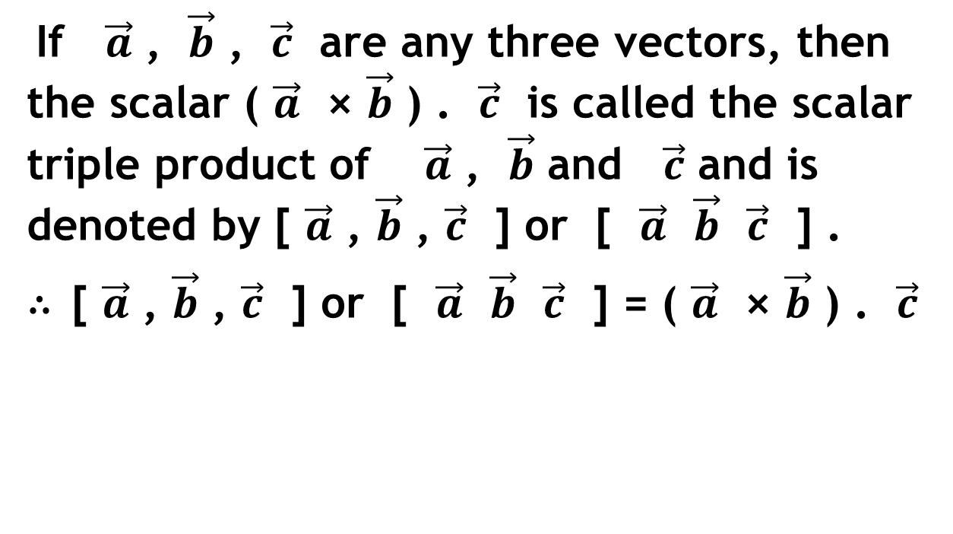
SCALER TRIPLE PRODUCT :
If $\vec{a}$ , $\vec{b}$ , $\vec{c}$ are any three vectors, then the scalar ( $\vec{a}$ × $\vec{b}$ ) . $\vec{c}$ is called the scalar triple product of $\vec{a}$ , $\vec{b}$ and $\vec{c}$ and is denoted by [ $\vec{a}$ , $\vec{b}$ , $\vec{c}$ ] or [ $\vec{a}$ $\vec{b}$ $\vec{c}$ ] .
∴ [ $\vec{a}$ , $\vec{b}$ , $\vec{c}$ ] or [ $\vec{a}$ $\vec{b}$ $\vec{c}$ ] = ( $\vec{a}$ × $\vec{b}$ ) . $\vec{c}$

Slide 5
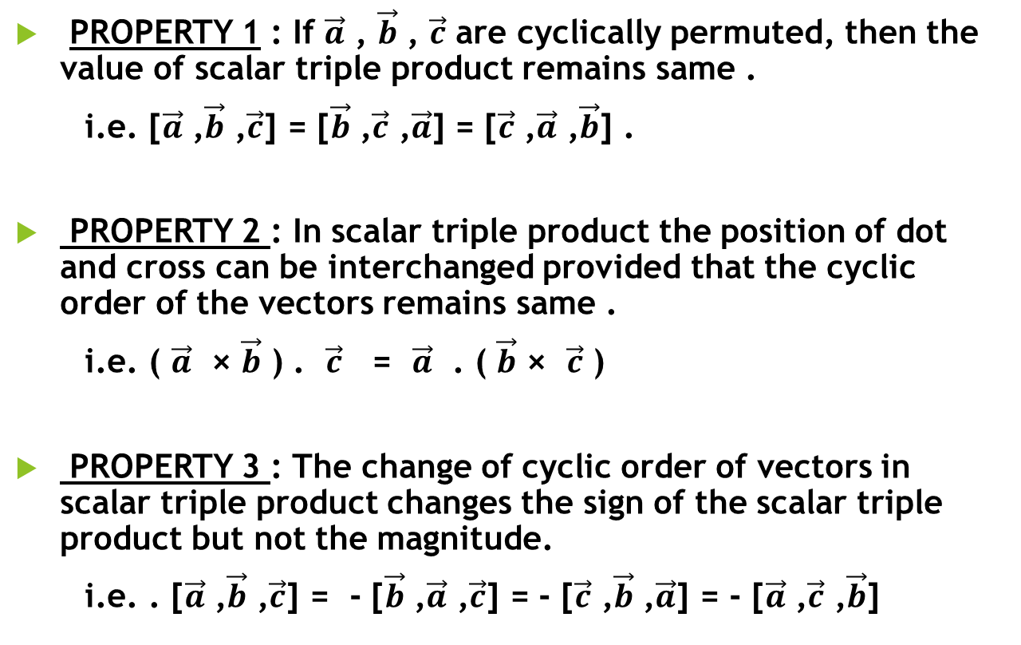
PROPERTIES OF SCALER TRIPLE PRODUCT :
PROPERTY 1 : If $\vec{a}$ , $\vec{b}$ , $\vec{c}$ are cyclically permuted, then the value of scalar triple product remains same .
i.e. [$\vec{a}$ ,$\vec{b}$ ,$\vec{c}$] = [$\vec{b}$ ,$\vec{c}$ ,$\vec{a}$] = [$\vec{c}$ ,$\vec{a}$ ,$\vec{b}$] .
PROPERTY 2 : In scalar triple product the position of dot and cross can be interchanged provided that the cyclic order of the vectors remains same .
i.e. ( $\vec{a}$ × $\vec{b}$ ) . $\vec{c}$ = $\vec{a}$ . ( $\vec{b}$ × $\vec{c}$ )
PROPERTY 3 : The change of cyclic order of vectors in scalar triple product changes the sign of the scalar triple product but not the magnitude.
i.e. . [$\vec{a}$ ,$\vec{b}$ ,$\vec{c}$] = - [$\vec{b}$ ,$\vec{a}$ ,$\vec{c}$] = - [$\vec{c}$ ,$\vec{b}$ ,$\vec{a}$] = - [$\vec{a}$ ,$\vec{c}$ ,$\vec{b}$]

Slide 6
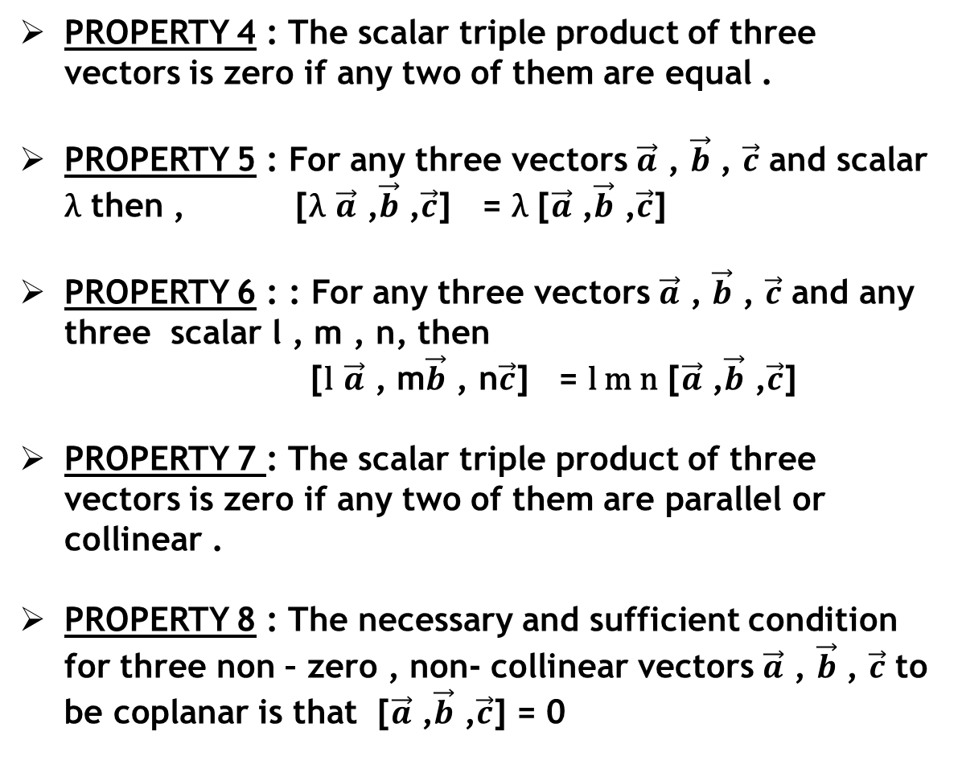
PROPERTY 4 : The scalar triple product of three vectors is zero if any two of them are equal .
PROPERTY 5 : For any three vectors $\vec{a}$ , $\vec{b}$ , $\vec{c}$ and scalar λ then , [λ $\vec{a}$ ,$\vec{b}$ ,$\vec{c}$] = λ [$\vec{a}$ ,$\vec{b}$ ,$\vec{c}$]
PROPERTY 6 : : For any three vectors $\vec{a}$ , $\vec{b}$ , $\vec{c}$ and any three scalar l , m , n, then
[l $\vec{a}$ , m$\vec{b}$ , n$\vec{c}$] = l m n [$\vec{a}$ ,$\vec{b}$ ,$\vec{c}$]
PROPERTY 7 : The scalar triple product of three vectors is zero if any two of them are parallel or collinear .
PROPERTY 8 : The necessary and sufficient condition for three non – zero , non- collinear vectors $\vec{a}$ , $\vec{b}$ , $\vec{c}$ to be coplanar is that [$\vec{a}$ ,$\vec{b}$ ,$\vec{c}$] = 0

Slide 7
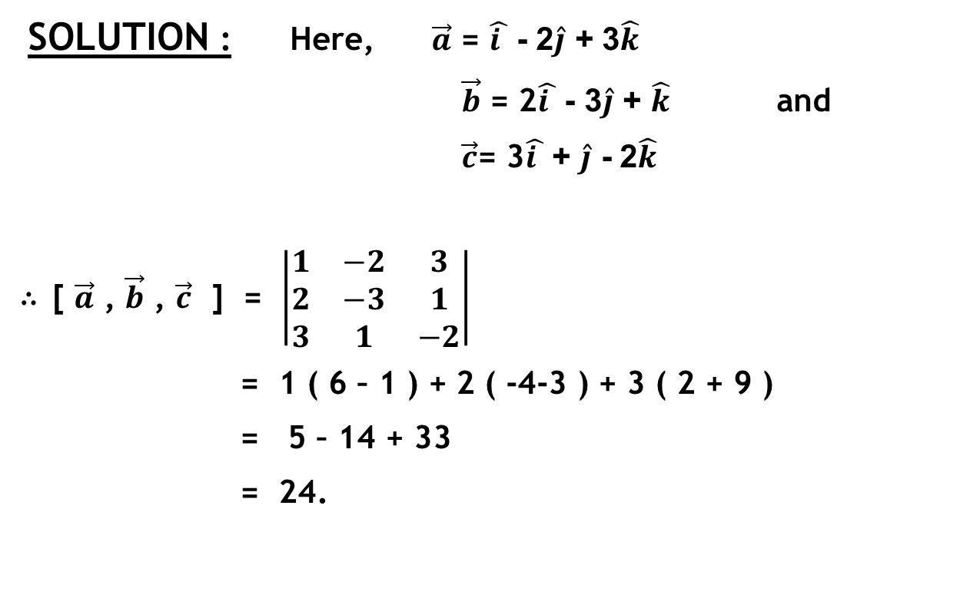
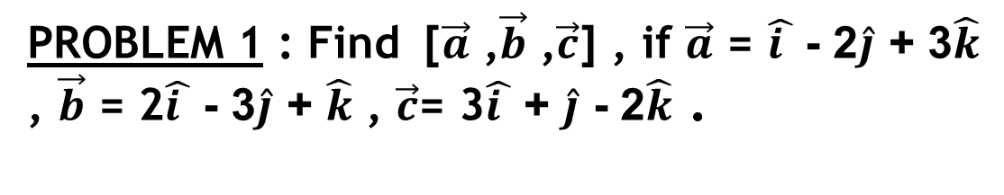
PROBLEM 1 : Find [$\vec{a}$ ,$\vec{b}$ ,$\vec{c}$] , if $\vec{a}$ = $\hat{i }$ - 2$\hat{j}$ + 3$\hat{k}$ , $\vec{b}$ = 2$\hat{i }$ - 3$\hat{j}$ + $\hat{k}$ , $\vec{c}$= 3$\hat{i }$ + $\hat{j}$ - 2$\hat{k}$ .
SOLUTION : Here, $\vec{a}$ = $\hat{i }$ - 2$\hat{j}$ + 3$\hat{k}$
$\vec{b}$ = 2$\hat{i }$ - 3$\hat{j}$ + $\hat{k}$ and
$\vec{c}$= 3$\hat{i }$ + $\hat{j}$ - 2$\hat{k}$
∴ [ $\vec{a}$ , $\vec{b}$ , $\vec{c}$ ] = $\left|\begin{matrix}1 & −2 & 3 \\ 2 & −3 & 1 \\ 3 & 1 & −2\end{matrix}\right|$
= 1 ( 6 – 1 ) + 2 ( -4-3 ) + 3 ( 2 + 9 )
= 5 – 14 + 33
= 24.

Slide 8
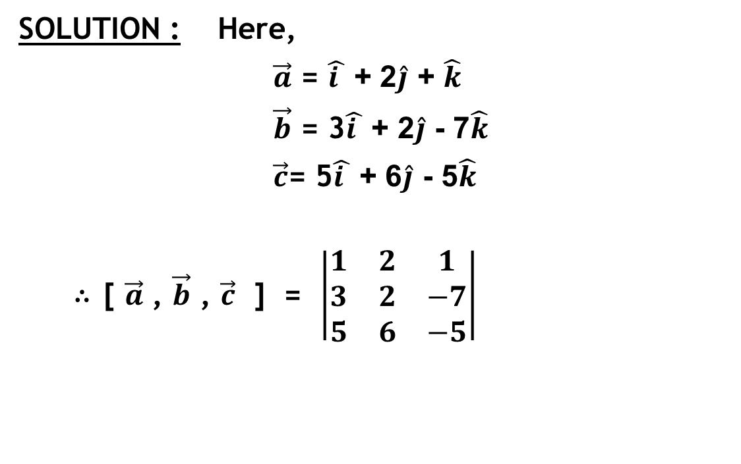
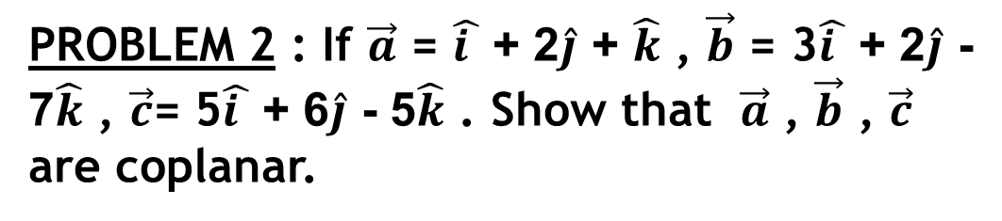
PROBLEM 2 : If $\vec{a}$ = $\hat{i }$ + 2$\hat{j}$ + $\hat{k}$ , $\vec{b}$ = 3$\hat{i }$ + 2$\hat{j}$ - 7$\hat{k}$ , $\vec{c}$= 5$\hat{i }$ + 6$\hat{j}$ - 5$\hat{k}$ . Show that $\vec{a}$ , $\vec{b}$ , $\vec{c}$ are coplanar.
SOLUTION : Here,
$\vec{a}$ = $\hat{i }$ + 2$\hat{j}$ + $\hat{k}$
$\vec{b}$ = 3$\hat{i }$ + 2$\hat{j}$ - 7$\hat{k}$
$\vec{c}$= 5$\hat{i }$ + 6$\hat{j}$ - 5$\hat{k}$
∴ [ $\vec{a}$ , $\vec{b}$ , $\vec{c}$ ] = $\left|\begin{matrix}1 & 2 & 1 \\ 3 & 2 & −7 \\ 5 & 6 & −5\end{matrix}\right|$

Slide 9
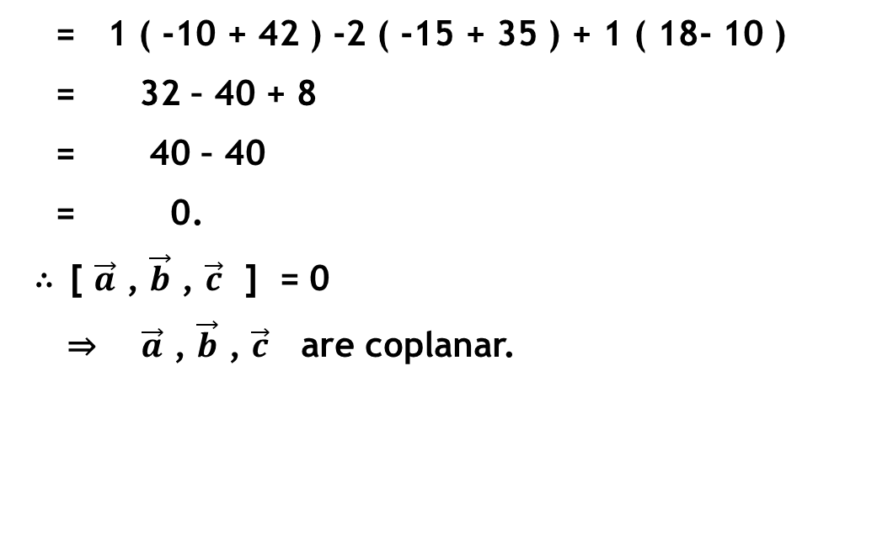
SOLUTION CONTINUES…
= 1 ( -10 + 42 ) -2 ( -15 + 35 ) + 1 ( 18- 10 )
= 32 – 40 + 8
= 40 – 40
= 0.
∴ [ $\vec{a}$ , $\vec{b}$ , $\vec{c}$ ] = 0
⇒ $\vec{a}$ , $\vec{b}$ , $\vec{c}$ are coplanar.

Slide 10
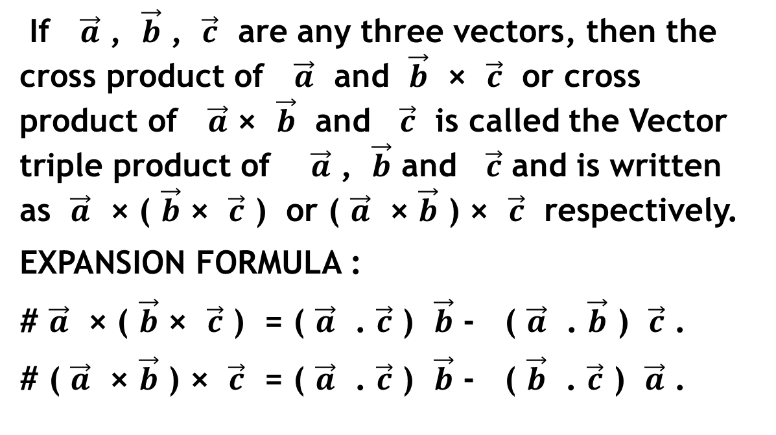
VECTOR TRIPLE PRODUCT :
If $\vec{a}$ , $\vec{b}$ , $\vec{c}$ are any three vectors, then the cross product of $\vec{a}$ and $\vec{b}$ × $\vec{c}$ or cross product of $\vec{a}$ × $\vec{b}$ and $\vec{c}$ is called the Vector triple product of $\vec{a}$ , $\vec{b}$ and $\vec{c}$ and is written as $\vec{a}$ × ( $\vec{b}$ × $\vec{c}$ ) or ( $\vec{a}$ × $\vec{b}$ ) × $\vec{c}$ respectively.
EXPANSION FORMULA :
# $\vec{a}$ × ( $\vec{b}$ × $\vec{c}$ ) = ( $\vec{a}$ . $\vec{c}$ ) $\vec{b}$ - ( $\vec{a}$ . $\vec{b}$ ) $\vec{c}$ .
# ( $\vec{a}$ × $\vec{b}$ ) × $\vec{c}$ = ( $\vec{a}$ . $\vec{c}$ ) $\vec{b}$ - ( $\vec{b}$ . $\vec{c}$ ) $\vec{a}$ .

Slide 11
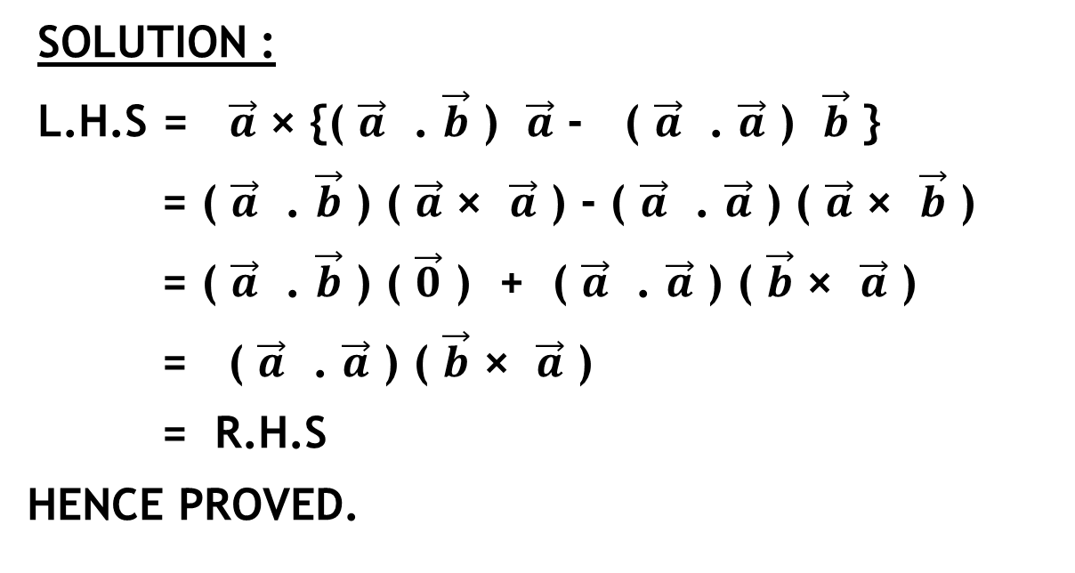
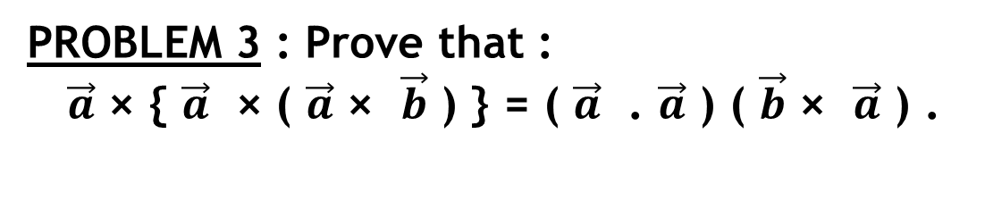
PROBLEM 3 : Prove that :
$\vec{a}$ × { $\vec{a}$ × ( $\vec{a}$ × $\vec{b}$ ) } = ( $\vec{a}$ . $\vec{a}$ ) ( $\vec{b}$ × $\vec{a}$ ) .
SOLUTION :
L.H.S = $\vec{a}$ × {( $\vec{a}$ . $\vec{b}$ ) $\vec{a}$ - ( $\vec{a}$ . $\vec{a}$ ) $\vec{b}$ }
= ( $\vec{a}$ . $\vec{b}$ ) ( $\vec{a}$ × $\vec{a}$ ) - ( $\vec{a}$ . $\vec{a}$ ) ( $\vec{a}$ × $\vec{b}$ )
= ( $\vec{a}$ . $\vec{b}$ ) ( $\vec{0}$ ) + ( $\vec{a}$ . $\vec{a}$ ) ( $\vec{b}$ × $\vec{a}$ )
= ( $\vec{a}$ . $\vec{a}$ ) ( $\vec{b}$ × $\vec{a}$ )
= R.H.S
HENCE PROVED.

Slide 12
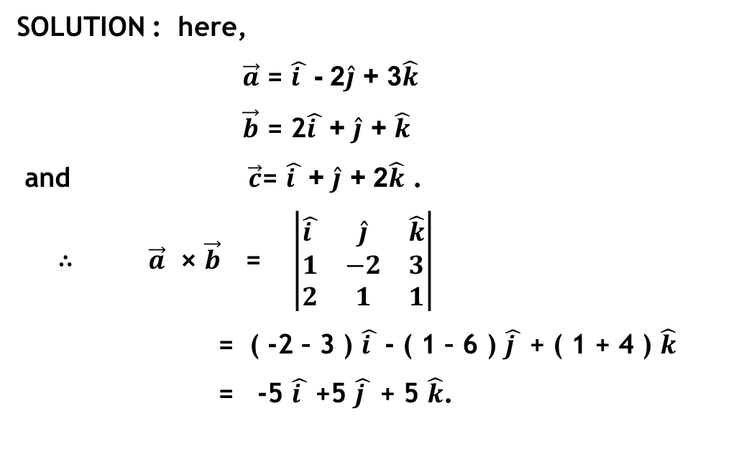
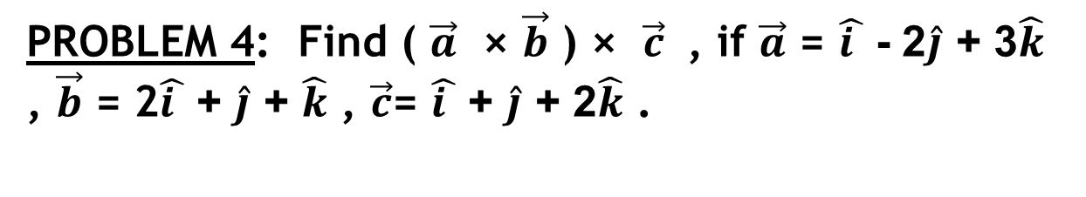
PROBLEM 4: Find ( $\vec{a}$ × $\vec{b}$ ) × $\vec{c}$ , if $\vec{a}$ = $\hat{i }$ - 2$\hat{j}$ + 3$\hat{k}$ , $\vec{b}$ = 2$\hat{i }$ + $\hat{j}$ + $\hat{k}$ , $\vec{c}$= $\hat{i }$ + $\hat{j}$ + 2$\hat{k}$ .
SOLUTION : here,
$\vec{a}$ = $\hat{i }$ - 2$\hat{j}$ + 3$\hat{k}$
$\vec{b}$ = 2$\hat{i }$ + $\hat{j}$ + $\hat{k}$
and $\vec{c}$= $\hat{i }$ + $\hat{j}$ + 2$\hat{k}$ .
∴ $\vec{a}$ × $\vec{b}$ = $\left|\begin{matrix}\hat{i } & \hat{j} & \hat{k} \\ 1 & −2 & 3 \\ 2 & 1 & 1\end{matrix}\right|$
= ( -2 – 3 ) $\hat{i }$ - ( 1 – 6 ) $\hat{j }$ + ( 1 + 4 ) $\hat{k}$
= -5 $\hat{i }$ +5 $\hat{j }$ + 5 $\hat{k}$.

Slide 13
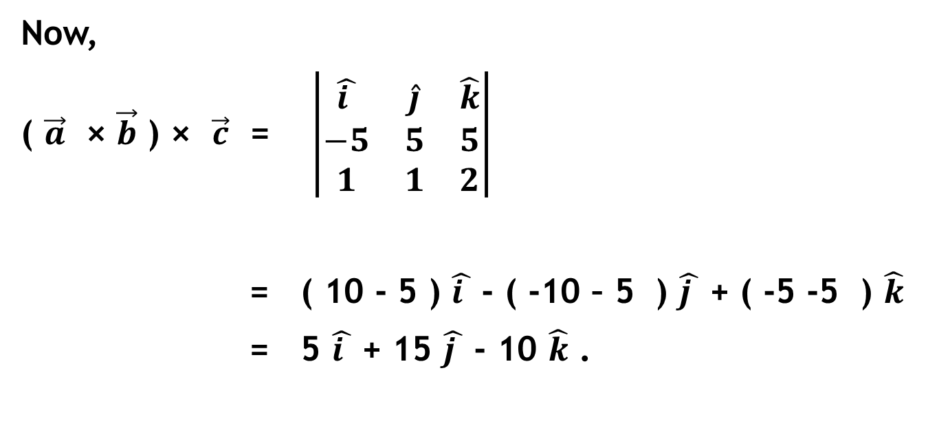
SOLUTION CONTINUES…
Now,
( $\vec{a}$ × $\vec{b}$ ) × $\vec{c}$ = $\left|\begin{matrix}\hat{i } & \hat{j} & \hat{k} \\ −5 & 5 & 5 \\ 1 & 1 & 2\end{matrix}\right|$
= ( 10 - 5 ) $\hat{i }$ - ( -10 – 5 ) $\hat{j }$ + ( -5 -5 ) $\hat{k}$
= 5 $\hat{i }$ + 15 $\hat{j }$ - 10 $\hat{k}$ .

